Slide 1
Quality Dashboard Highlights:
Structured to comprise 3 “levels”; Departmental/channel, Team, and Counsellor
Accessible via web link (https://apps.kidshelpphone.ca/tools/counselling-kpis-stats/index.html) – ‘Quality Analytics’ section
Dashboard updates dynamically as categories/content is selected
ETL process starts with iCarol raw data extract, then data is cleaned and pasted into PowerBI-linked dataset

Slide 2
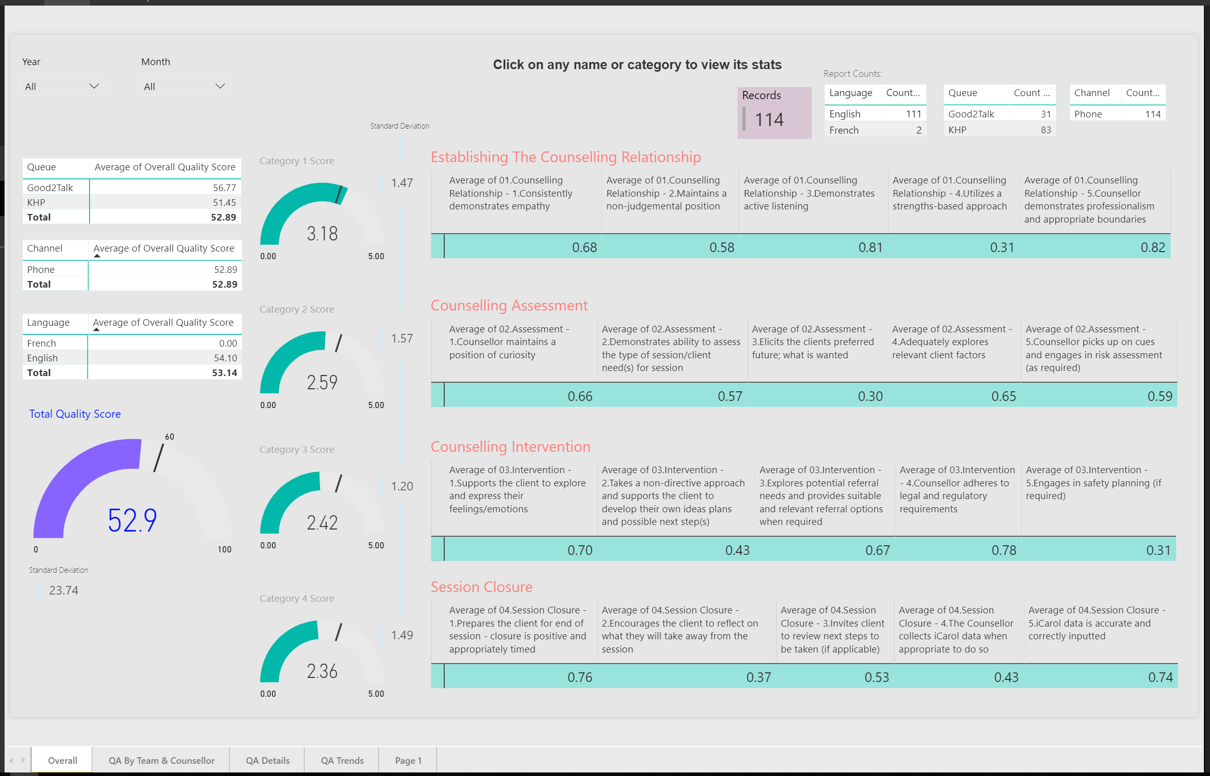
Top Level: Channel Overview
Criteria and drilldowns of site, team, and individual, can be done in real-time, with the data updating dynamically as criteria is selected.
Total quality score displayed here (target is 60 pts out of 100) along with standard deviation
4 main Counselling Quality standard ‘pillars’ are displayed by their average score. This is critical in helping the service identify not just overall quality scores but each specific area of the quality pillars. This helps the service to understand counselling strengths and weaknesses and focuses coaching, training, and supervision efforts.

Slide 3
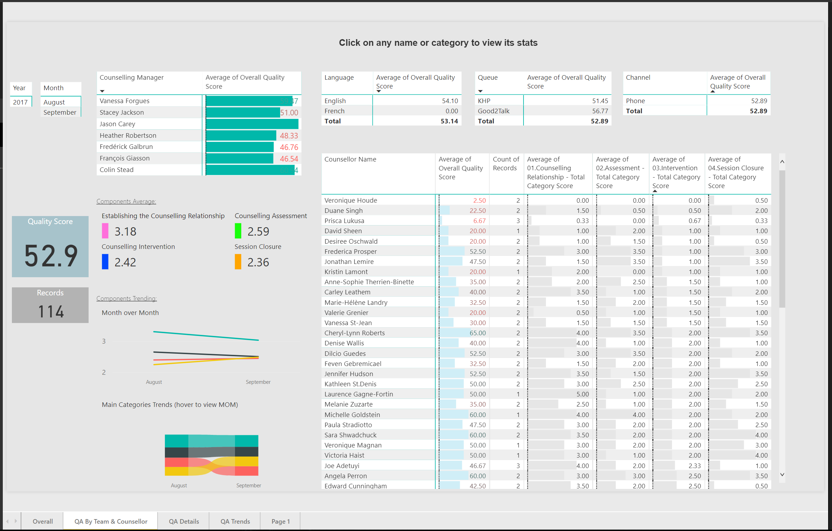
Second Level : Team Overview
User can click on a name and it will display their team’s specific quality data including summary data for each employee in the table to the bottom right

Slide 4
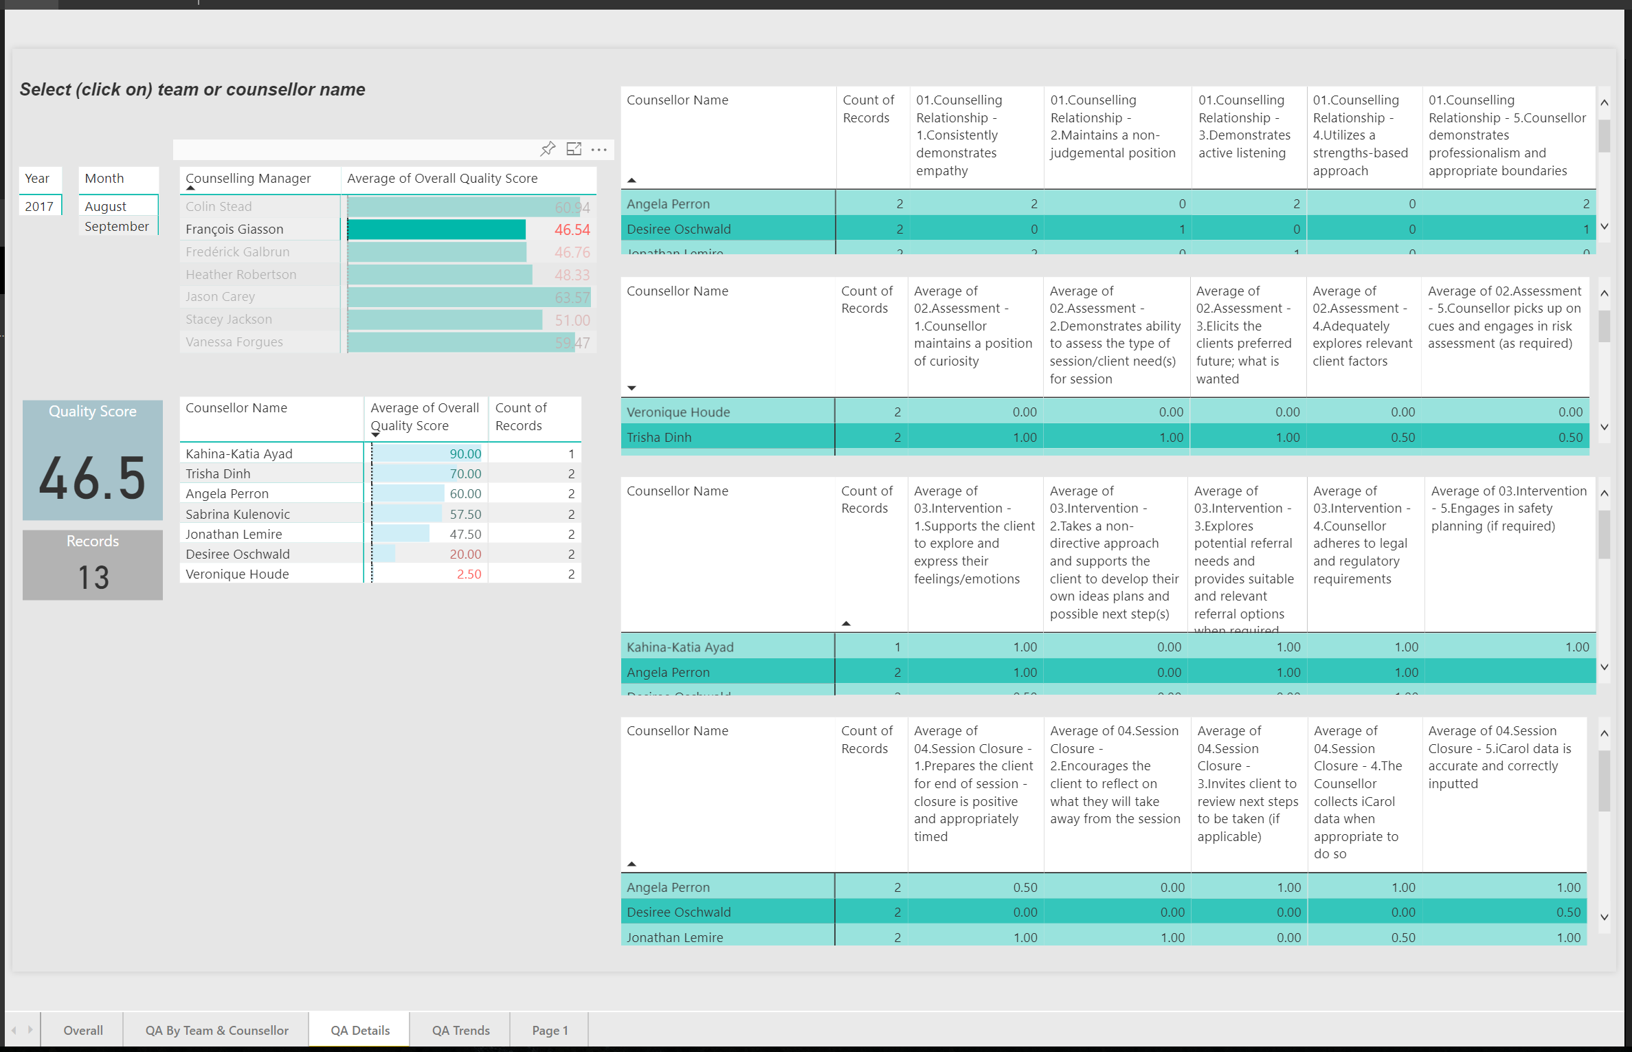
Third Level : Person Overview
User can click on a name and it will display their team’s specific quality data including detailed counselling component data for each employee in the table to the right
Unlike the previous 2 reports, this report covers in detail average scores for each specific component within the 4 main pillars. Scores are out of 1 with a .60 average (60%) being a pass.

